Slide 1
Welcome!
Lesson 1.1
Notes:
Simple welcome

Slide 2
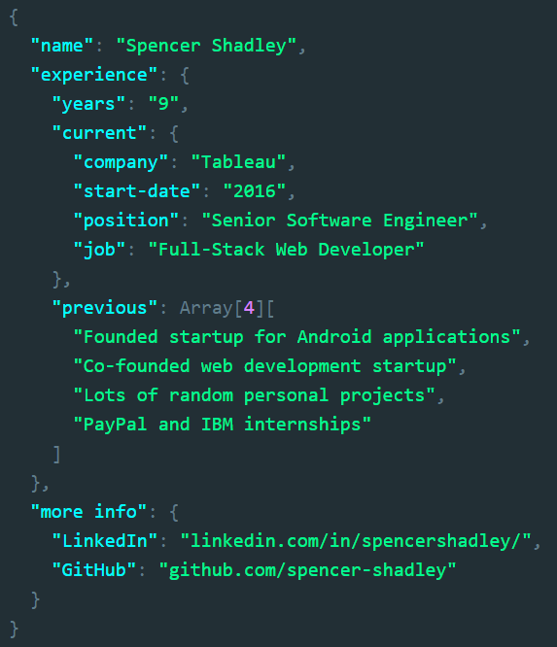
Who Am I? [Experience]
Notes:
Just read the JSON
9 years of programming experience
Currently work at Tableau (since 2016)
Senior Software Engineer
Full-stack web developer
Previous experience
Founded startup for Android applications
Co-founded web development startup
Various random personal projects
Internships – PayPal, IBM
The University of Texas at Austin
B.S. in Computer Science
More info
linkedin.com/in/spencershadley/
github.com/spencer-shadley

Slide 3
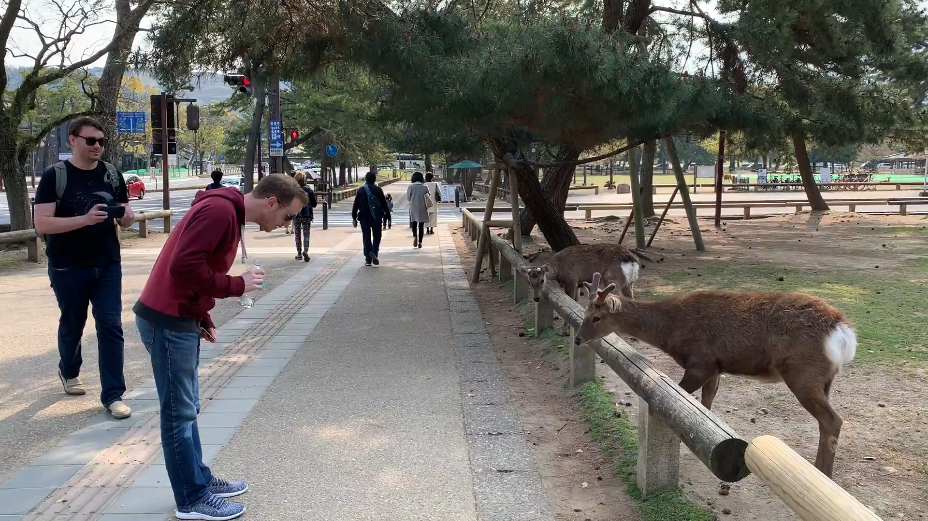


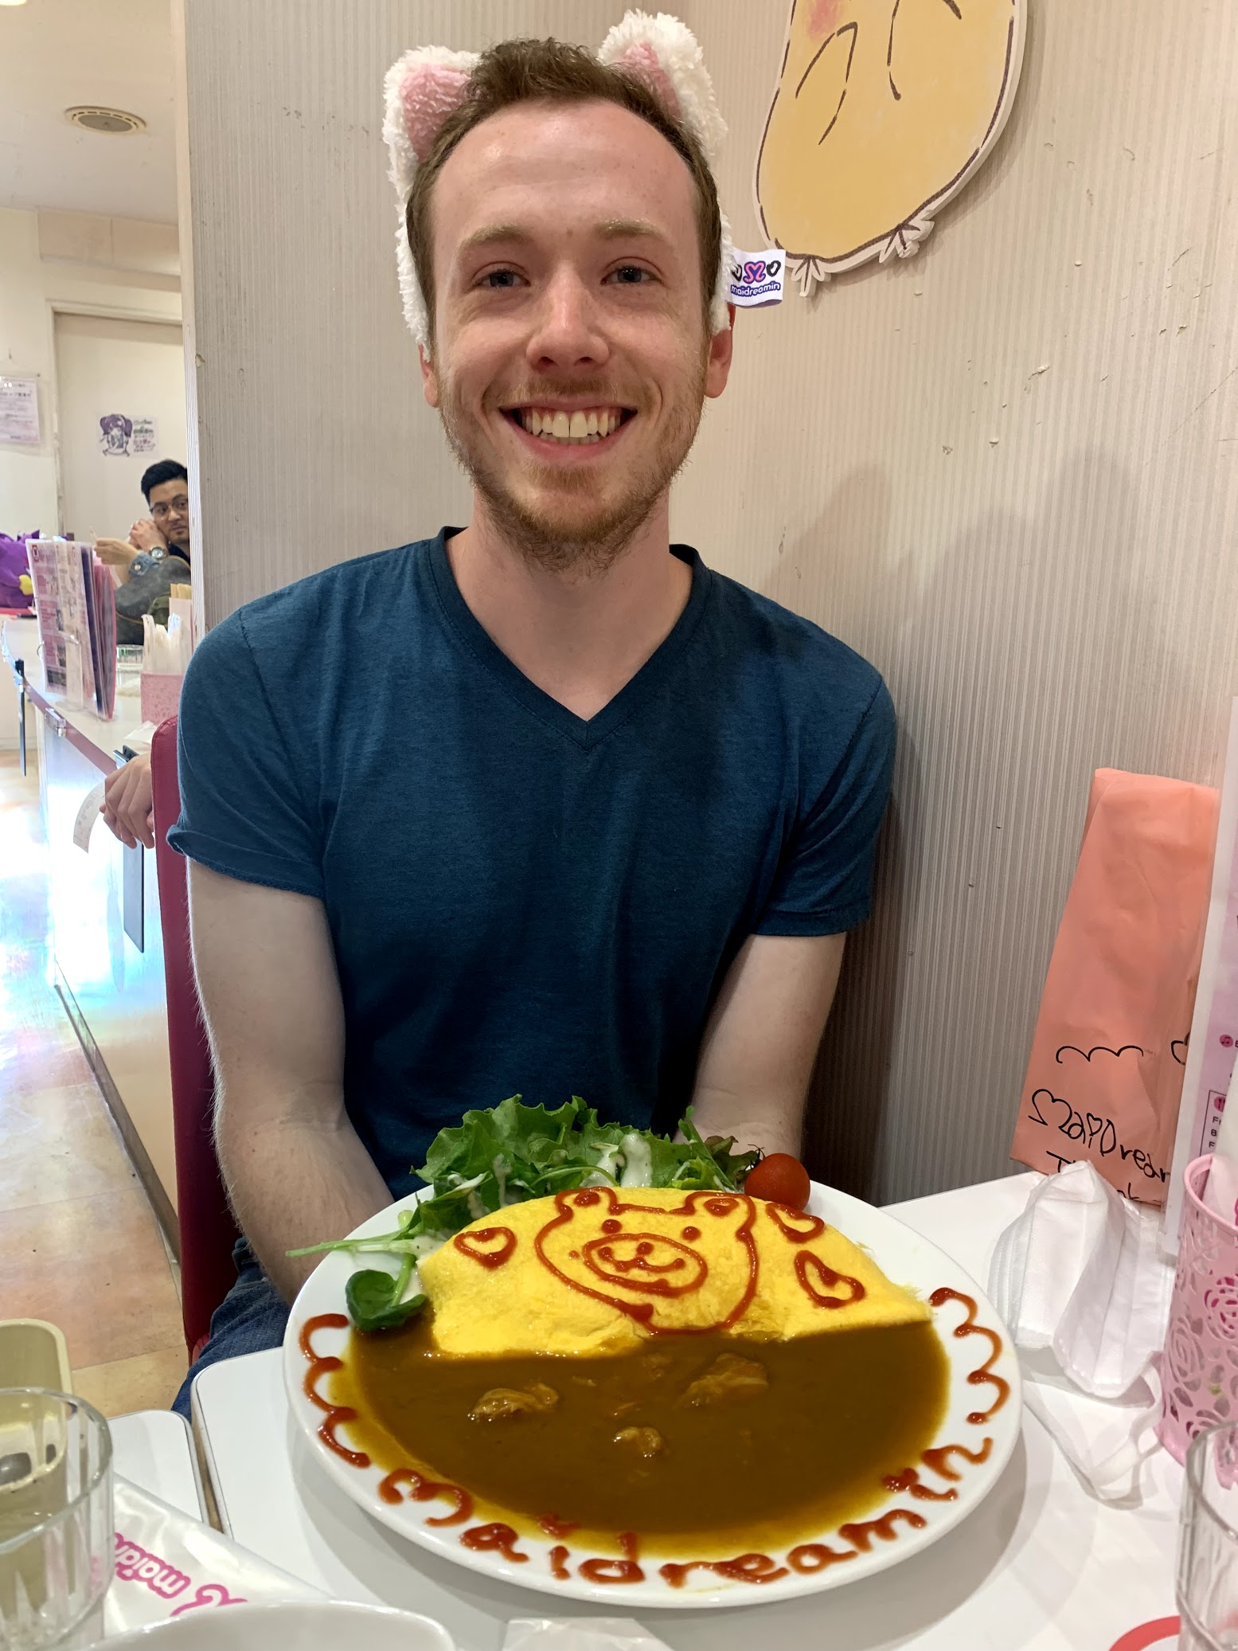


Who Am I? [Fun Fact]
Notes:
Japan is awesome
I love anime

Slide 4










Who Am I? [How I got into software]
Notes:
Wasn’t allowed to use a computer
CS 1 in high school
Android development
Developed curriculum
UT
Bizler
Tableau
http://clipart-library.com/clipart/1203829.htm

Slide 5
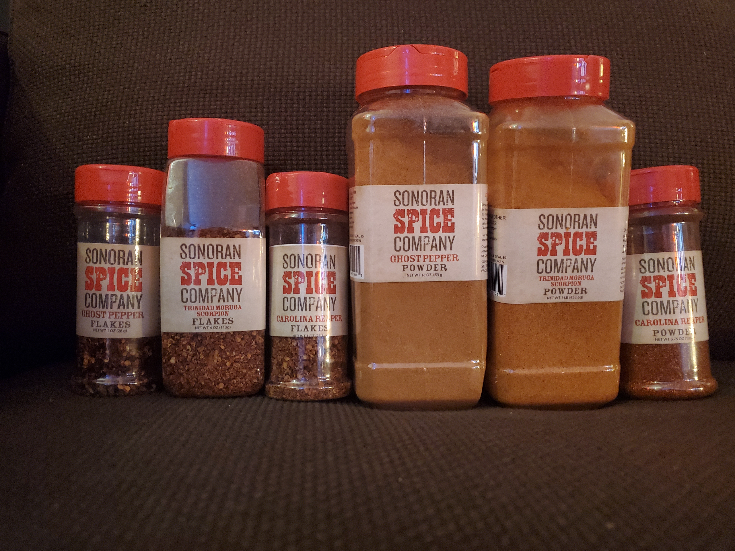
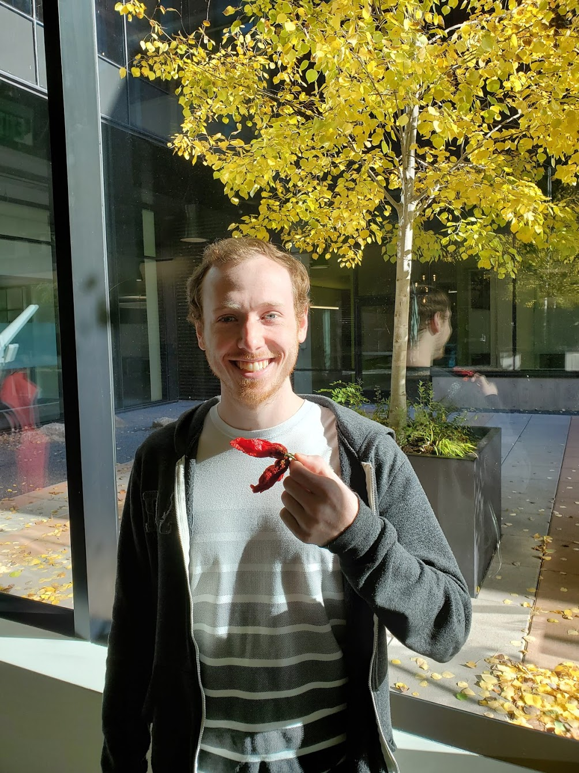
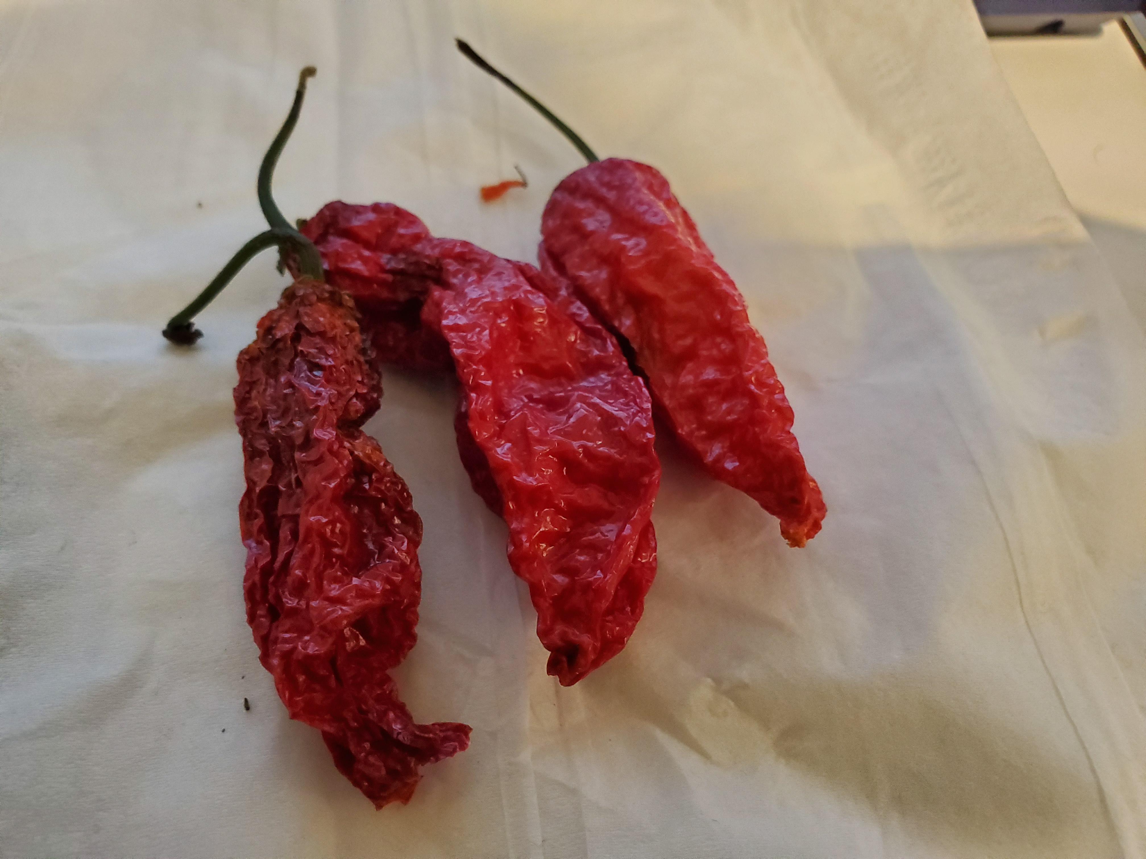
Who Am I?
Notes:
Spicy food eater
Already in other slides

Slide 6
Who are you?
Write your name on a sticky note (LARGE)
(optional) Draw a picture that represents you
Stick it on the back of your laptop

Slide 7
Introduce Yourself
What’s your name?
What’s your background (career, education, etc.)?
What motivated you to take this Bootcamp?
If you were the eighth dwarf, what would your name be?
Notes:
What’s your name?
What’s your background (career, education, etc.)?
What motivated you to take this Bootcamp?
If you were the eighth dwarf, what would your name be?
What house would you be sorted into at Hogwarts?
Hobby

Slide 8
Today’s Schedule
Today we’ll cover the following:
Introduce ourselves
Goals and how to be successful in this course
About the course
Intro to Terminal / Console / Bash
Code! Make your first webpage
Discuss Resources and Homework
Notes:
Here’s what our days will look like.
Question: How do you learn to code? (NEXT)

Slide 9
Your Goals
And why do you want a new career?
To pursue a dream
To escape a dead-end job
To be able to create
To follow a fascination
To attain financial stability
To obtain financial freedom
To challenge yourself
To be a role model to kids

Slide 10
Our Goal = Enable Your Goals This is why we’re here. We want to help you achieve your goals.
We =
Instructor, TAs, Student Success Manager, Career Coaches, etc.

Slide 11
There’s a lot of stuff in web development
We are going to learn >80 technologies
Notes:
This will be a lot of work
Most people do this over four years full-time plus internships
We have six months
It’s called bootcamp for a reason
Office hours, Slack, email, I’ll make extra time if you need it

Slide 12
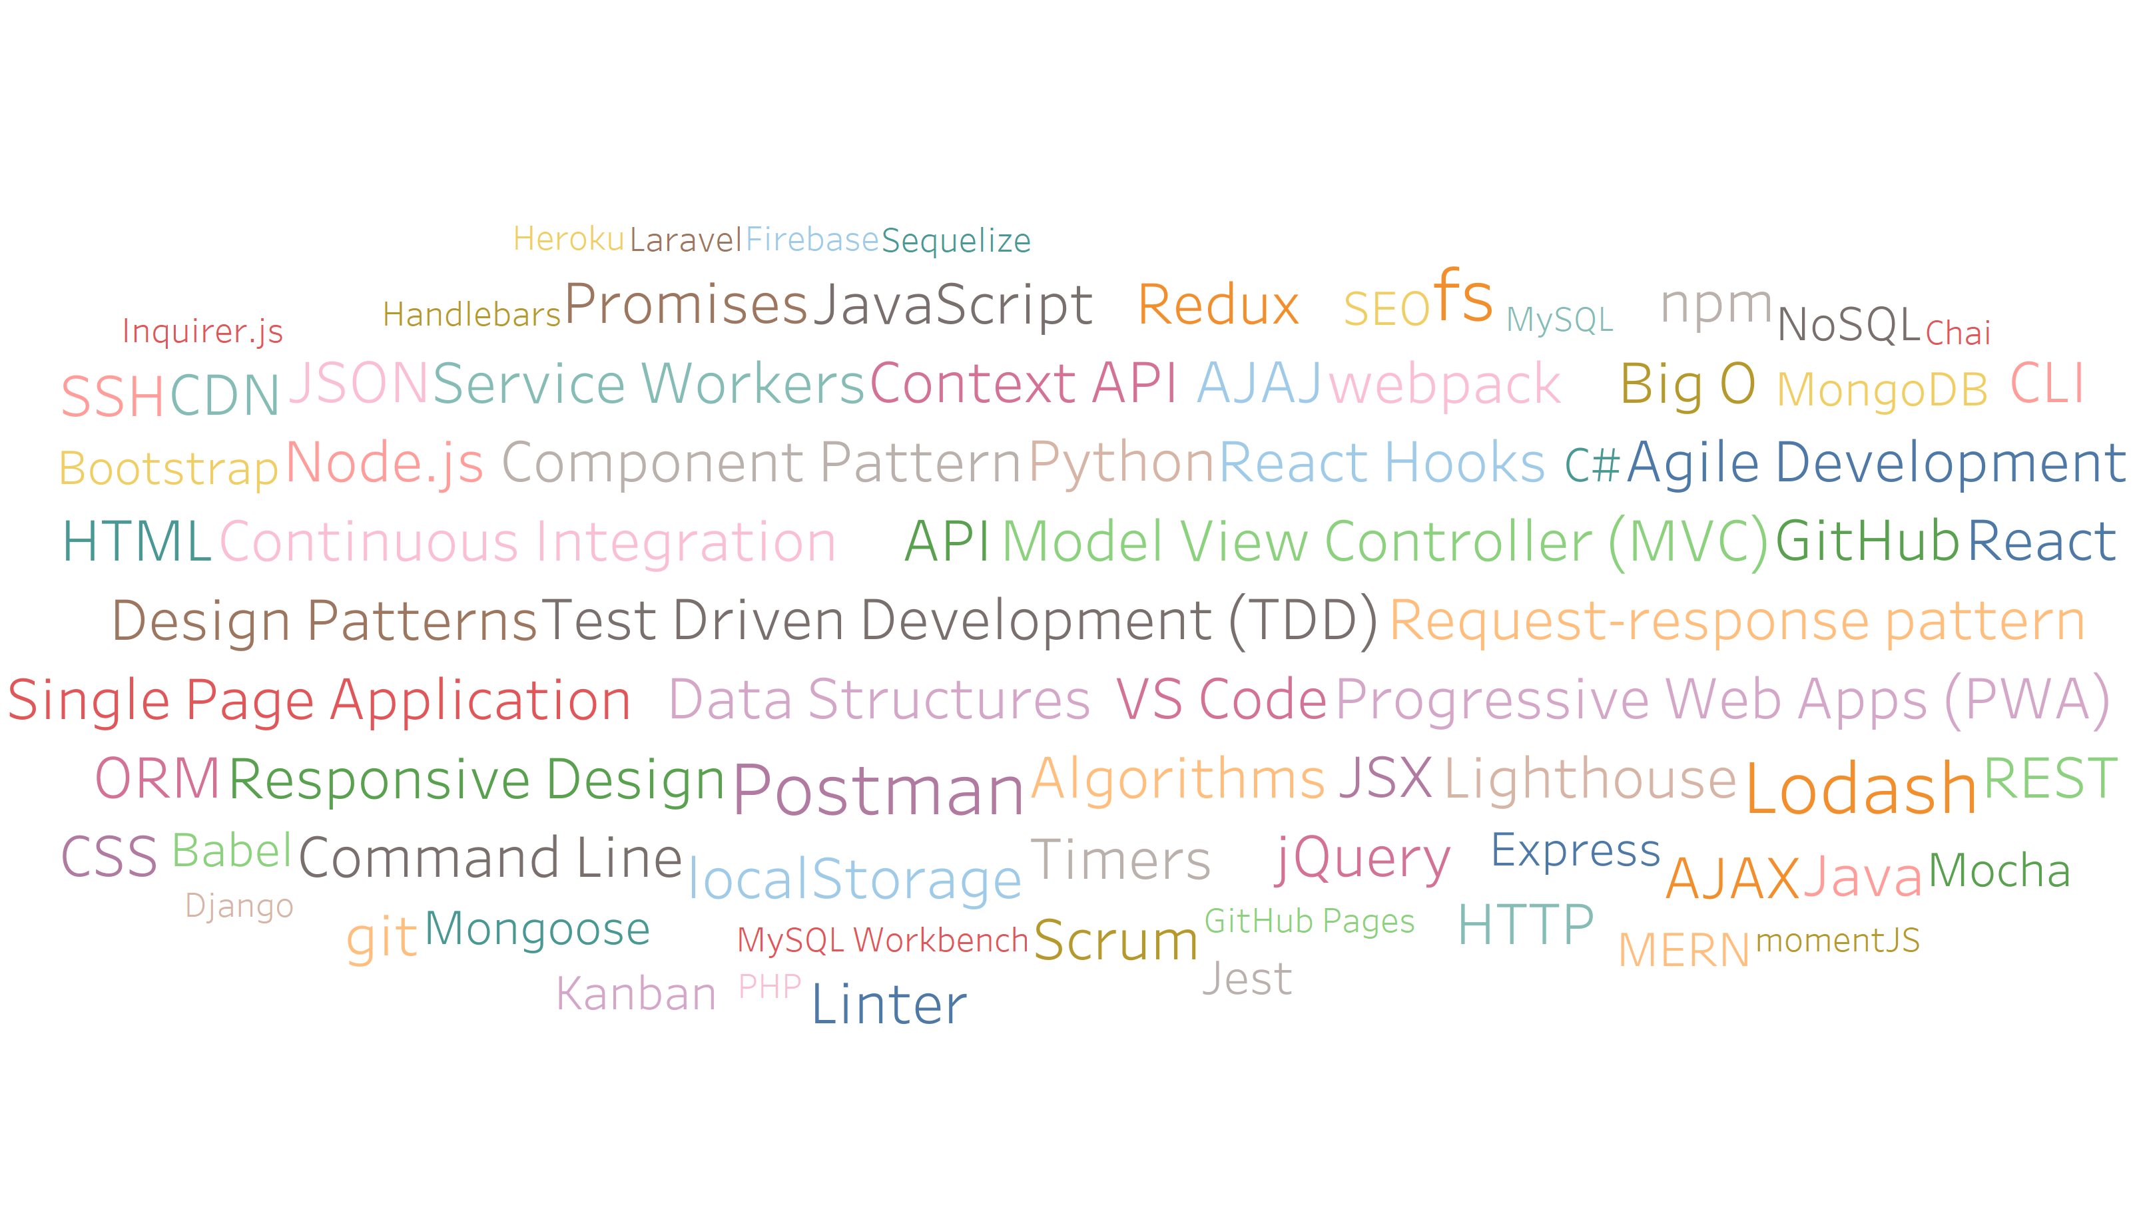
So many technologies!

Slide 13
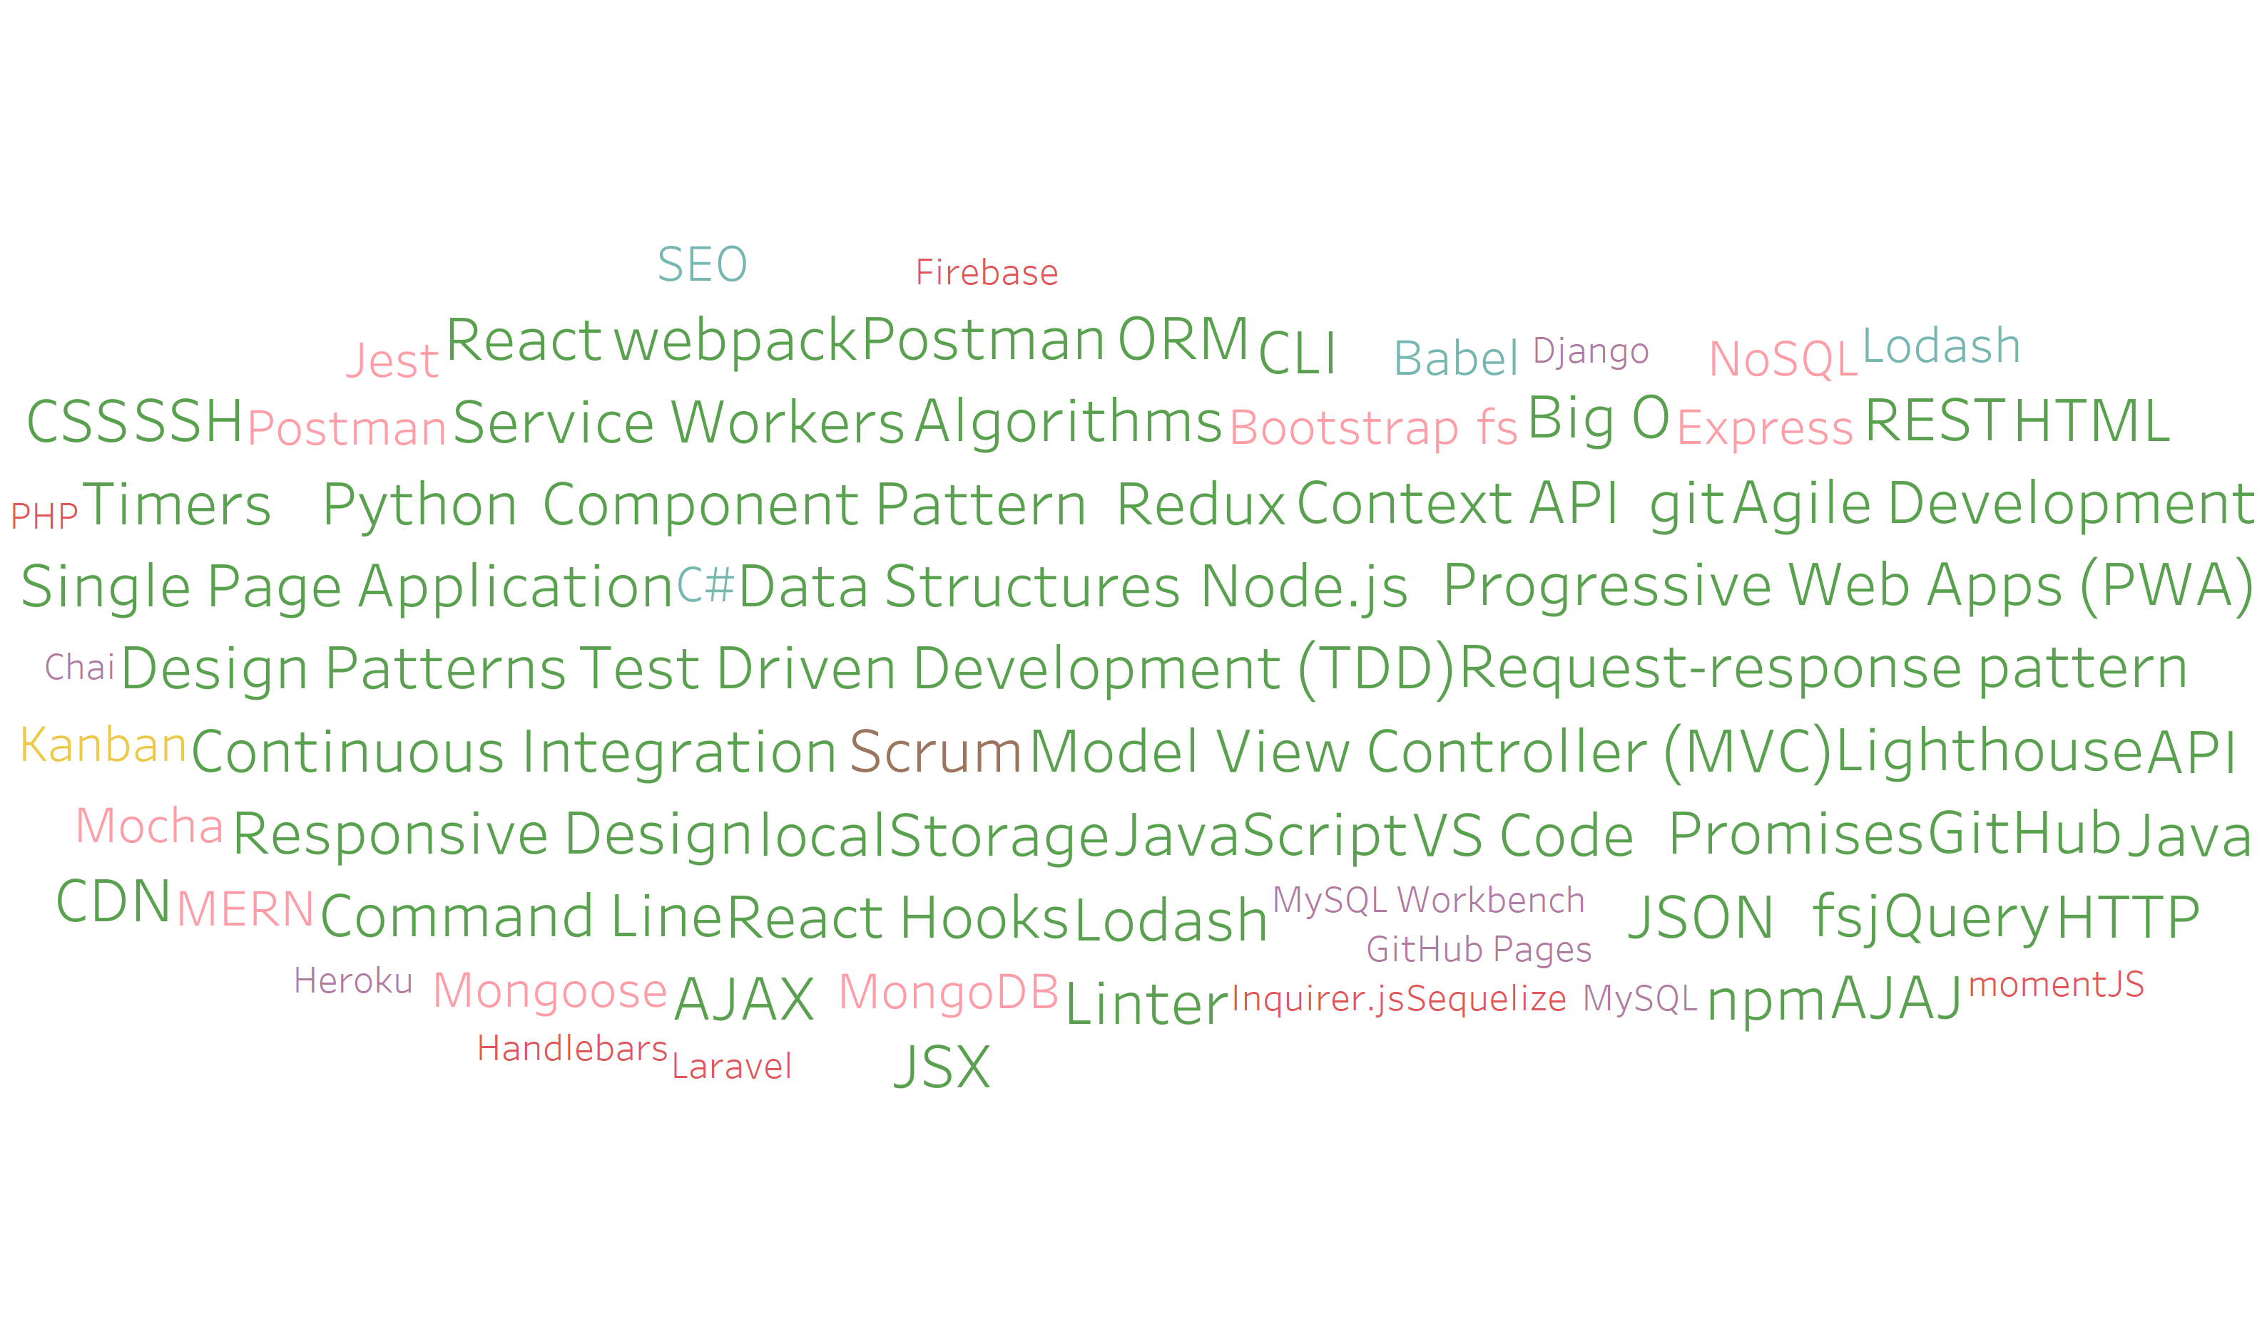
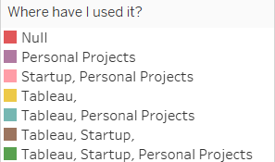
So many technologies!
Notes:
92.1% used by Tableau or startups

Slide 14
The Path of Learning

Slide 15
You can’t learn what you think you already know
“It is impossible for a man to learn what he thinks he already knows.” - Epictetus, Discourses, Book II, ch. 17
Notes:
Those that have the hardest time in the program are not the ones who came in knowing no programming.
It’s not the ones who haven’t played around with HTML, CSS, or Javascript.
It’s the ones who walk in thinking they either A) Know more than they do. Or B) Are experts in a completely different field.
There is something that stops people like this from accepting the reality.
-----
You are a blank slate. Seriously. Don’t lose sight of this image. At first it may feel intimidating. Knowing how little you know. But relish the opportunity and take the privileges it comes with.
You have permission to struggle. To fail. To not “get” everything immediately.

Slide 16
Nothing comes easy.
As students, you face three
HUGE obstacles.
Notes:
… there are a few obstacles in the way.
Things that will frustrate you…

Slide 17

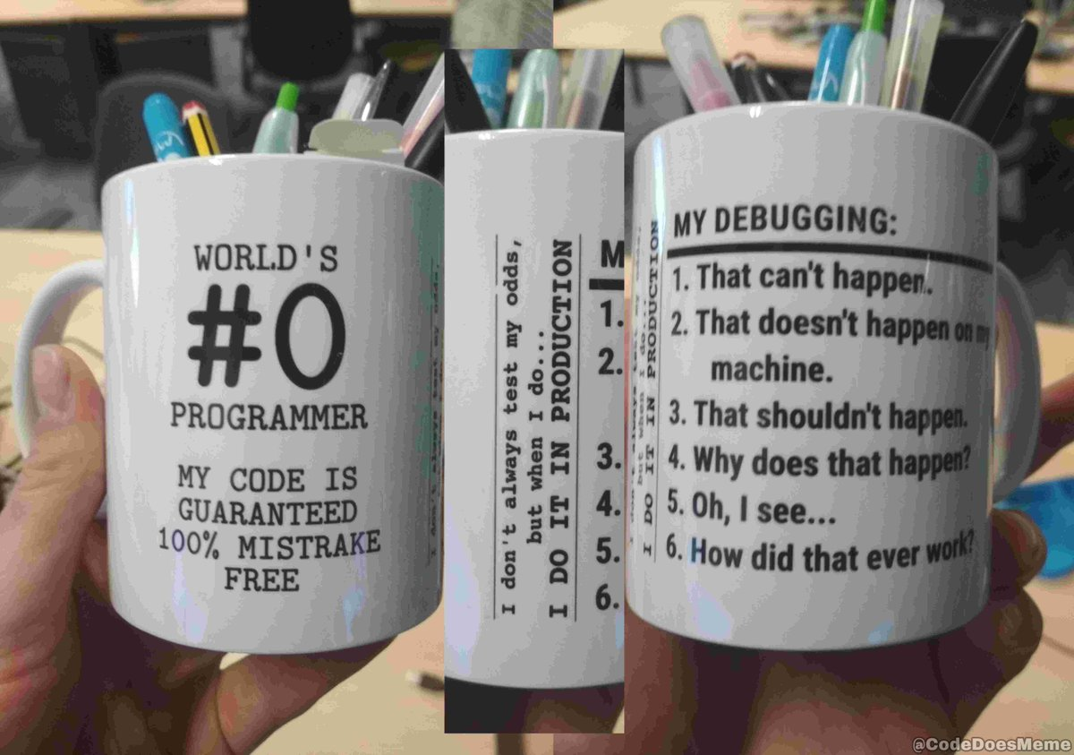
Obstacle #1: The Great Confusion
10 states of a programmer
1: My code doesn't work and I don't know why.
10: My code works and I don't know why.
Notes:
Shutterstock_1188695488
Obstacle 1 First, learning to code is tough, intimidating, and frustrating at times. You should forget about your uncle/brother-in-law/friend/step-sister who told you about so-and-so learning to build apps in 1 week. Coding is hard. It will take time. There is no way around that.
It’s confusing, difficult, and there’s a ton to learn. But it’s super rewarding when you _do_ learn why your code broke or is working.
shutterstock_1188695488

Slide 18

Obstacle #2: The Great Doubt
“Maybe I’m just dumb.”
Notes:
Shutterstock_215771662
Obstacle 2
There will be many moments where you will doubt yourself.
shutterstock_215771662
Everyone is on the same page as you. No-one in this classroom is dumb. You all have varying backgrounds with differing experiences and exposure.
Everyone was where you are at some point in their career. Every single developer. Me too.
It takes time but you have what it takes; you were selected for this program because we know you have what it takes.
The first few weeks will be difficult, but everyone will be on a pretty level playing field a few weeks in.
In my first computer science class I didn’t know what Windows Explorer was, what a file was or how to open a file

Slide 19

Obstacle #3: The Great Distance
If you want to go fast, go alone.
If you want to go far, go together.
-African Proverb
Notes:
Shutterstock_411452953
Obstacle 2 – you have a ton of ground to cover!
There’s a lot to learn, and it can be intimidating. But honestly, 6 months will be over before you know it.
Because of the length of the program, personal issues WILL come up during the course of the program, and it will be challenging to stay motivated.
You should see each other as a family embarking on a long journey. You will become far closer to your peers than you realize. Intensity is no substitute for endurance.
-----
And will take a while to master. Persisting in general is the #1 hardest thing in this course.
Perhaps tied with having self-confidence (talk about imposter syndrome - https://en.wikipedia.org/wiki/Impostor_syndrome).
“If the individual responded to the task with over-preparation, the successful outcome will be seen as a result of hard work. If the individual responds by procrastination, they will view the outcome as a matter of luck. In the impostor cycle, gaining success through hard work or luck is not interpreted as a matter of true, personal ability.”

Slide 20

Learning Can Be Frustrating
You can’t tell whether you’re learning something when you’re learning it—in fact, learning feels a lot more like frustration.
What I’ve learned is that during this period of frustration is actually when people improve the most, and their improvements are usually obvious to an outsider. If you feel frustrated while trying to understand new concepts, try to remember that it might not feel like it, but you’re probably rapidly expanding your knowledge.
—Jeff Dickey, author of Write Modern Web Apps with the MEAN Stack: Mongo, Express, AngularJS, and Node.JS (Peachpit Press, 2014)
Notes:
Frustration = learning, seriously. Here’s the author of a pretty famous book on the mean stack:
So how do we get through this frustration and actually learn?

Slide 21

Celebrate your success
Notes:
Frustration = learning, seriously. Here’s the author of a pretty famous book on the mean stack:
So how do we get through this frustration and actually learn?
https://gfycat.com/optimalelaboratehoneybee

Slide 22

Google Fu: The Most Important Skill of All
What Is Google Fu?
Notes:
Of course, to do this, you’ll need to be great at googling!
This is arguably the best/most important skill you can use.
It’s silly, but being able to find the answers to your questions is extremely important, and people won’t always be around. Google should almost always be your first go-to (it has almost every answer, if you know how to find it).
shutterstock_653127499

Slide 23
Course Structure
Notes:
Now that we’ve talked about the journey and how to be successful, let’s talk about the stops along the way.

Slide 24
Daily Schedule
In each class, we’ll cover the following:
Set objectives
Brief background lecture
Watch me/coding demos
Code discussions
In-class exercises
Project work
Notes:
Here’s what our days will look like.
Question: How do you learn to code? (NEXT)
By coding! Unfortunate, right?
We’ll get a ton of in-class practice reading and writing code, so the course quickly becomes “code-centric”.
Most days will be much less presentation-heavy than today.
Questions?

Slide 25

The House Cup
Notes:
Mention we will be keeping track of the house cup

Slide 26
Prework
Notes:
So next up I want to spend a little bit of time checking that everyone has everything they need installed (from the pre-work).
If you can check off all of these things, spend this time helping your neighbors. This should become a habit – try to ask for help form your neighbors before going to a TA (you will both learn more along the way). < We’ll talk more about this soon.
That said, let’s check some things off of a list.

Slide 27
Software Checklist
At this point, you should have all of these installed:
Slack
Google Chrome
Visual Studio Code
Git Bash (Windows) or Terminal (Mac)
Git
Node.js
Heroku-CLI
Notes:
Slack – please include an actual picture of yourself as your avatar

Slide 28
Accounts Checklist
You should also have accounts for:
GitHub (with SSH Integration)
Heroku
LinkedIn
Stack Overflow

Slide 29
The Modern Web

Slide 30
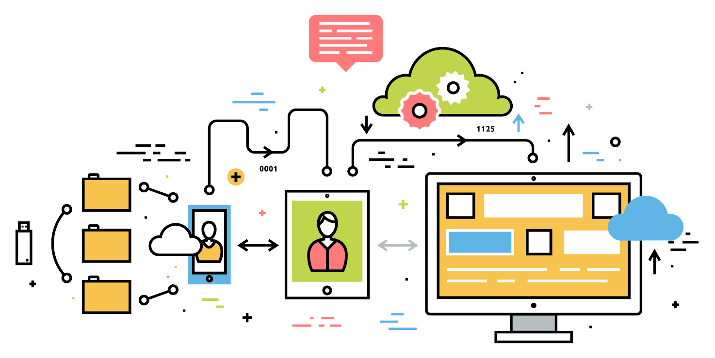
What Exactly Is Full-Stack Development?
Notes:
Ask students: So what do you think it means to be a “full stack developer?”

Slide 31
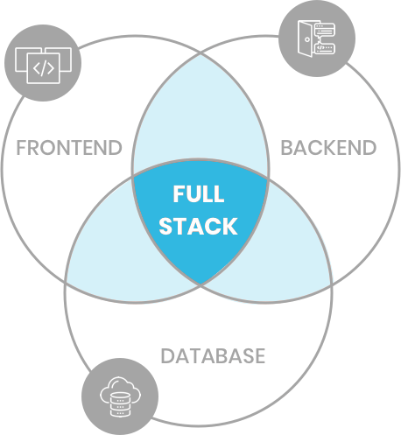
Full-Stack Development
Full-stack development is writing code which supports an entire web application
Front-end development to visually display an application to the user.
Back-end development, such as APIs on a server
Database for long-term (non-volatile) storage. This is used by the server. Sometimes this is considered part of the back-end.
Notes:
http://www.teclogiq.com/images/fullstack-development.png

Slide 32

The “Magic” of YouTube
Notes:
Let’s use YouTube as an example. (Go to YouTube and do basic search)
You’ll learn all of this in time, but a basic YouTube search requires two things:
A ”frontend” – the graphical user interface which responds to what I type
A “backend” – the code on the “server side” that is able to do the logic behind the search, find the relevant videos, and send them along
(Go to next slide)
shutterstock_1024261021

Slide 33




Full-Stack Development
FSF FLOW
In modern web apps, there’s a constant back-and-forth communication between two key components: the visuals displayed in the user’s browser (front end) and the data and logic stored on the server (back end).
Browser shows webpage to user
Web browser
Front-end
User makes
a request
Browser talks to server
Server sends HTML back to browser
Database
Server queries database
Server
Back-end
Database returns query results
Server passes data to template engine
Template engine renders HTML
Template engine
Notes:
Websites today are all about reading code for these components – “front-end” and “back-end”

Slide 34
> Terminal

Slide 35
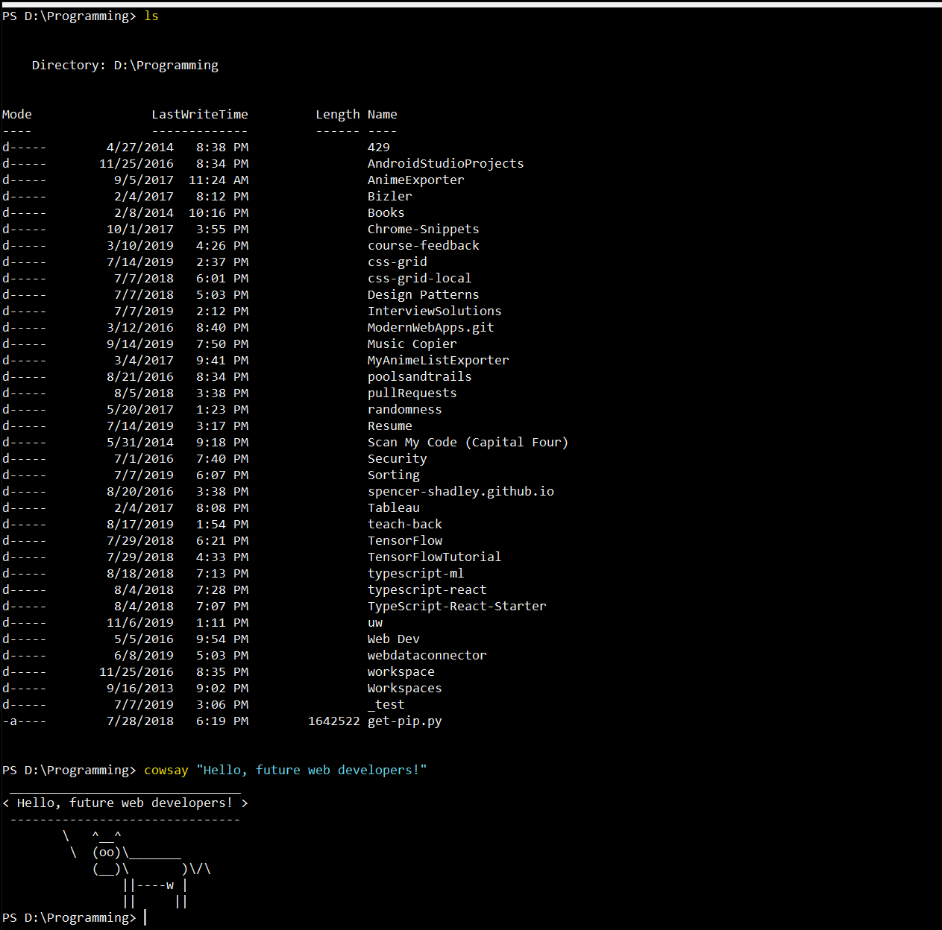
Intro to Console/Terminal
Notes:
The terminal is the portal to your computer – it allows you to run and even script commands that can create files, folders, and more.
It is extremely important that you get intimately familiar with the terminal as soon as possible, as you’ll use it for almost everything. It is fast and powerful.
NEXT

Slide 36
> Intro to Console
Notes:
So let’s run through a couple of examples.

Slide 37

Console Commands
Best Practices:
Always use lowercase for directory and file names
Never put spaces in directory or file names
Use dashes to separate words in directory and file names (dash-case)
Notes:
TAs: Slack out the activity

Slide 38
Activity: Console Commands
12 minutes

Slide 39

Activity: Console Commands
Suggested Time: 12 minutes
From the terminal/console and using only the command line:
BONUS!
Create a new directory with the name first-day-stuff.
Create a new HTML file with the name first-day.html.
Open the current folder containing the new HTML file.
Create multiple directories/folders with the names one-folder and second-folder with one command.
Create multiple files with the names one.html and two.html with one command in the first-day-stuff directory.

Slide 40
Pop Quiz - Console Commands
List files and directories
Change directory
Create a new directory
Delete (remove) any directory
Create a new file
Delete (remove) a file
Open file or directory in VS Code
Print a cow
> ls
> cd my-cool-directory
> mkdir my-new-directory
> rmdir –r my-directory
> touch my-new-file
> rm my-file
> code file-or-directory
> cowsay “I like turtles”
Notes:
Ask the class if they found any cool new commands we didn’t cover

Slide 41
Pop Quiz - Console Utilities
Alias for the current directory’s path
Alias for the parent directory’s path
Alias for your home directory
Tab auto-complete
Kill a currently running process
Up arrow
Google “Linux command for…”
> .
> ..
> ~
> cd <tab>
> ctrl+C
> Cycles through previous commands

Slide 42

Intro to Console: Discuss with Neighbors
Notes:
Re-ask the questions after a couple of minutes walking neighbor-discussion:
How do you create a new folder?
How do you create a new file?
shutterstock_81648802

Slide 43
Hello, HTML
Notes:
Now that you can create HTML files from the terminal, let’s create one and actually write some HTML.
Do the activity for creating an html page

Slide 44
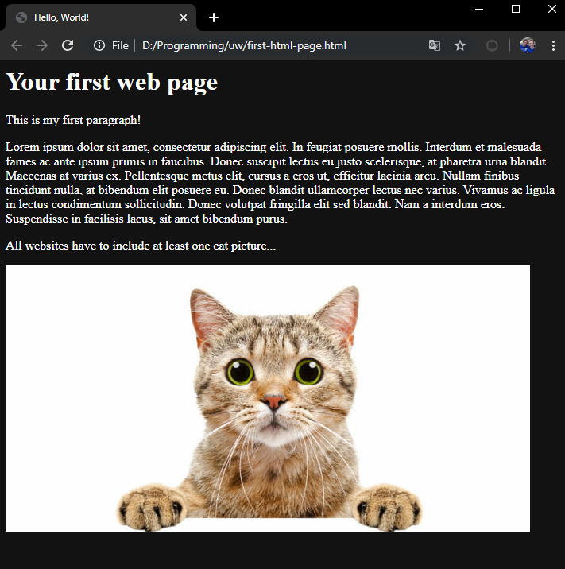
<title>Intro to HTML</title>
HTML5
HTML is one of the three base languages behind every website.
It defines all the basic content and a bit of formatting.
It is a markup language. This means there is some base information which has additional context added to it by “marking” it up.

Slide 45
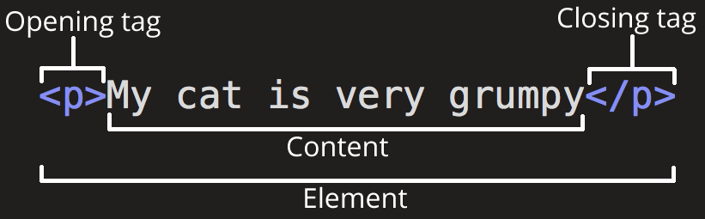
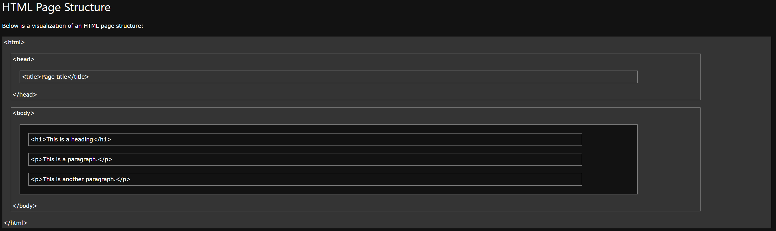
<html>Intro to HTML</html>
Parts of an element
Content: The base text
Tag: Indicates beginning and end of an element
Attribute: Additional information about an element
Element: The marked up content
Nesting Elements
HTML pages are composed of elements inside elements
To add more information we wrap items in additional tags and add attributes
Resources
https://www.google.com/ (yes, this really is the best resource)
https://www.w3schools.com/html/
https://developer.mozilla.org/en-US/docs/Web/HTML
Notes:
Images from :
https://developer.mozilla.org/en-US/docs/Learn/HTML/Introduction_to_HTML/Getting_started
And
https://www.w3schools.com/html/html_intro.asp

Slide 46
Activity: Intro to HTML
10 minutes

Slide 47
Activity: Intro to HTML
Suggested Time: 5 minutes
In a new HTML file, create the basic structure of an HTML document and include the following in it:
DOCTYPE declaration
Head tag with a title tag
H1 tag with a title of your choice
An embedded image
Now add the following three links to your page:
One link that has target="_blank" so that it opens a new tab when clicked
One link that is bold
One link that is only a placeholder (it goes nowhere)
BONUS!
Create an ordered list of steps to make a sandwich
Create an unordered list of five bands/musicians you like
Create a table with two columns (animal class and animal name) and four rows of animals
Use an alternate way of separating links without line breaks
Embed a YouTube video of your favorite band/musician

Slide 48

<title>Intro to HTML</title>
How’d it go?

Slide 49
Weekly Homework Assignment
Thursday 11/21

Slide 50
Mini Homework Assignment
Next Class

Slide 51
Mini Homework Assignment
Due Date: Next Class
1
Star the GitLab repo for our class
2
Play with some terminal commands. Try the class examples again!
3
Go through W3 Schools HTML tutorials and documentation
(HTML HOME through HTML Paragraphs)
4
Make an HTML page
(Watch the walkthrough video if you feel a bit lost.)
5
(optional) More practice: https://developer.mozilla.org/en-US/docs/Learn/HTML/Introduction_to_HTML

